Slide 1
go get

Slide 2
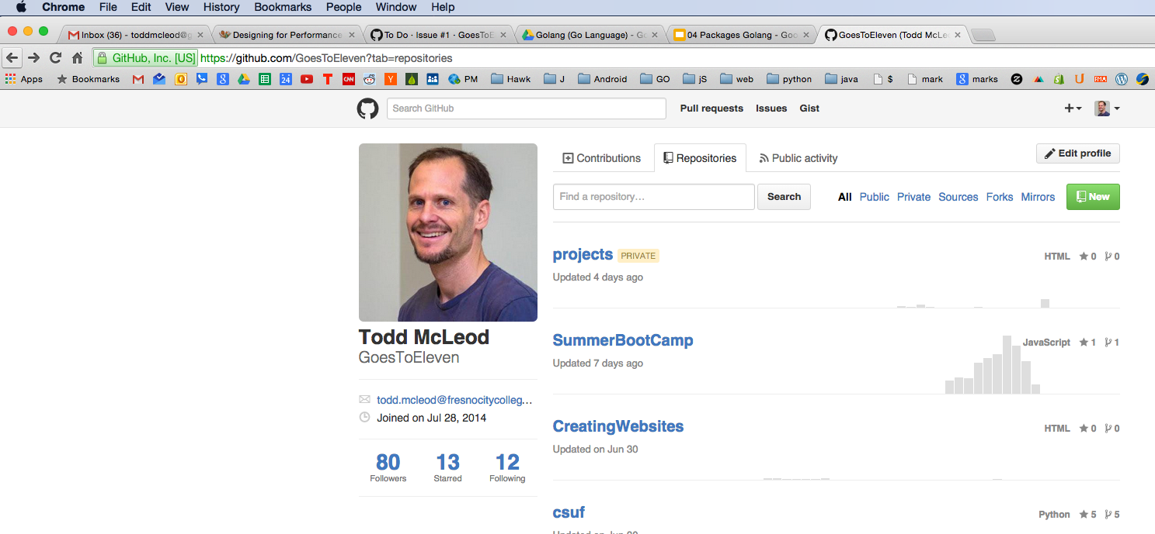
Create a new github repo ...

Slide 3
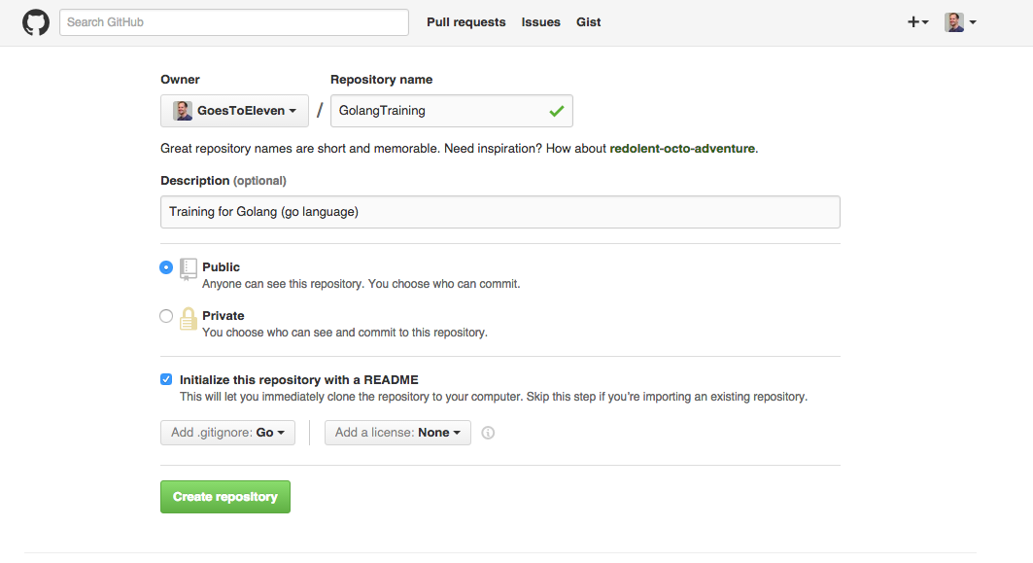
Create a new github repo ...

Slide 4
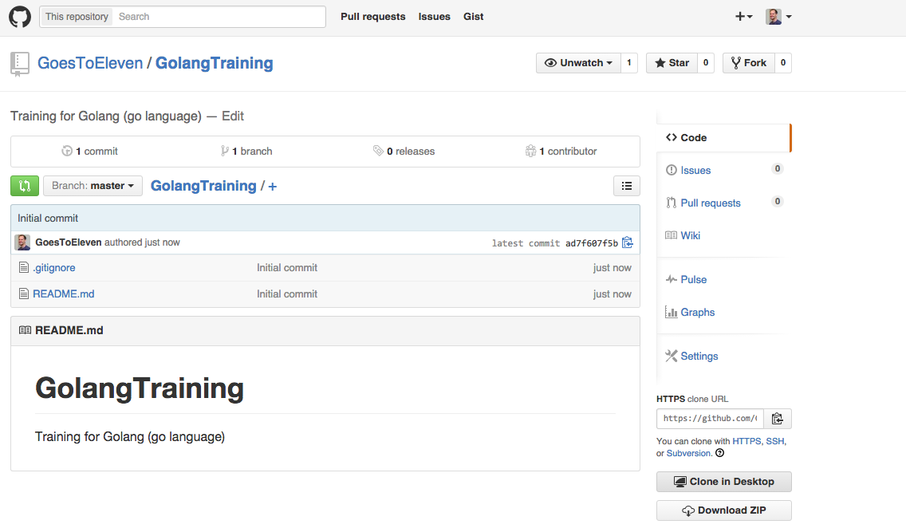
clone repo to your computer ...

Slide 5
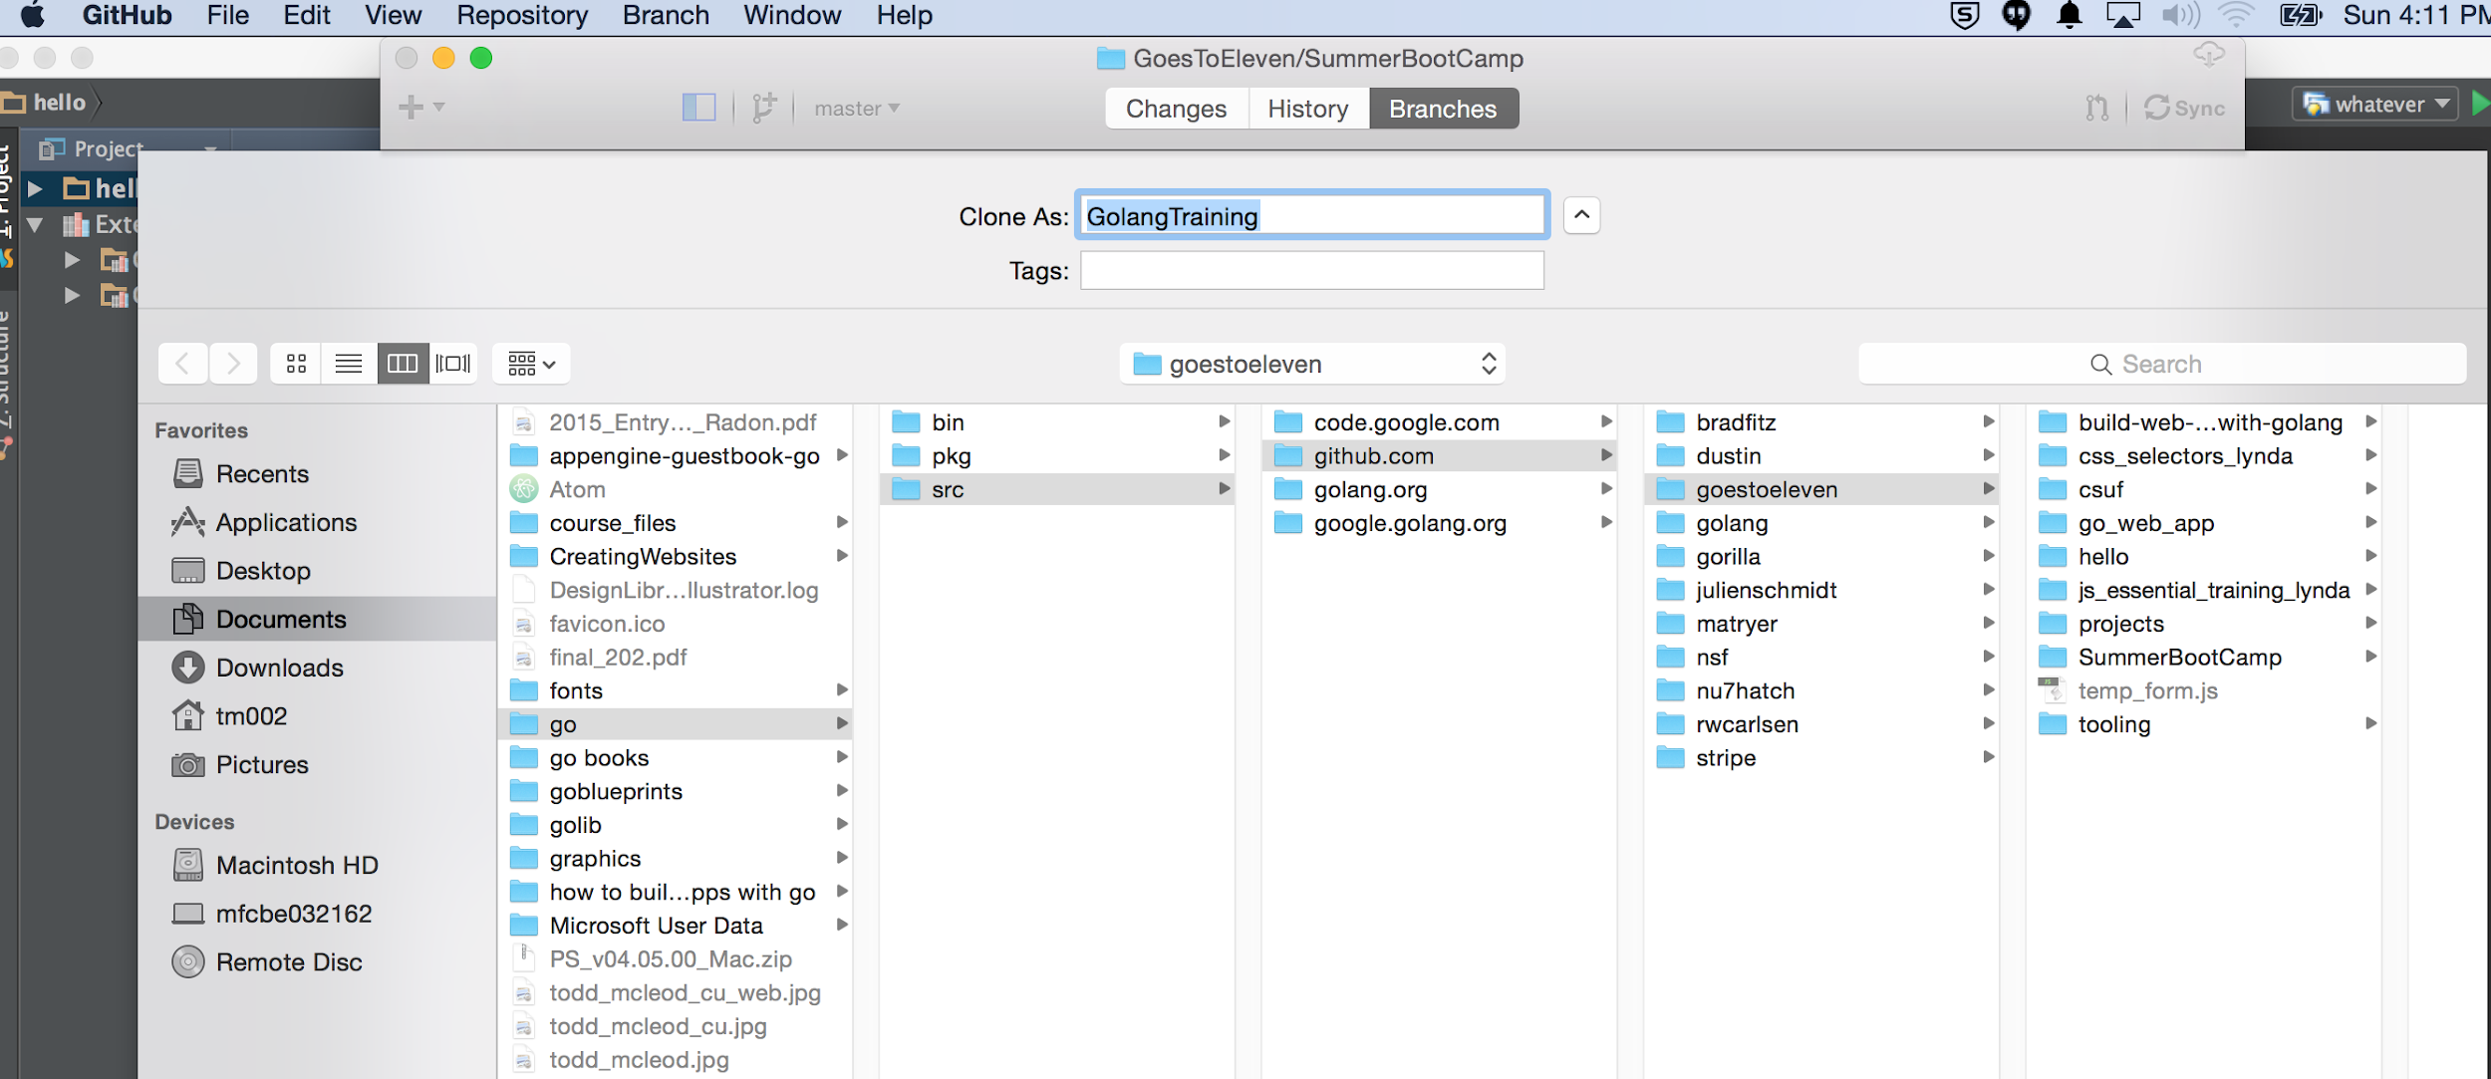
clone repo to your computer ...

Slide 6
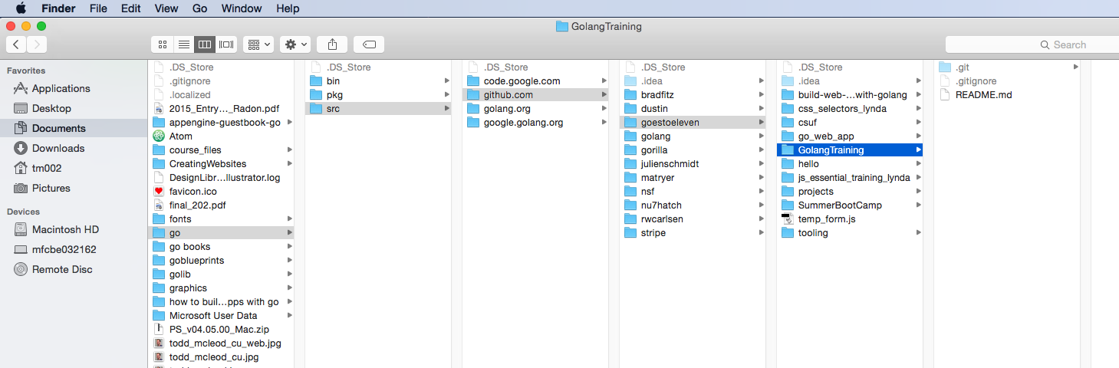
clone repo to your computer ...

Slide 7
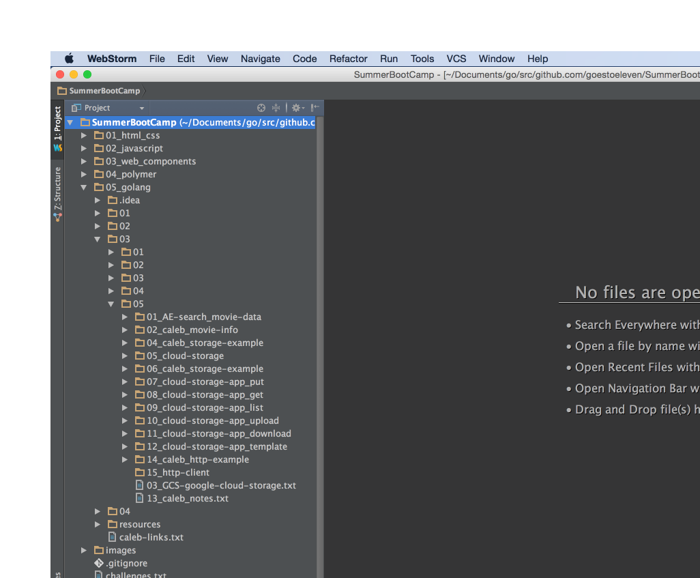
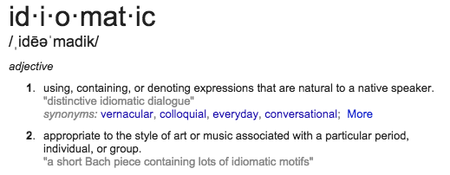
Example of folder structure:
not idiomatic go
shouldn’t start packages (folders) with a number
I use this style, however, for storing sequentially organized files

Slide 8
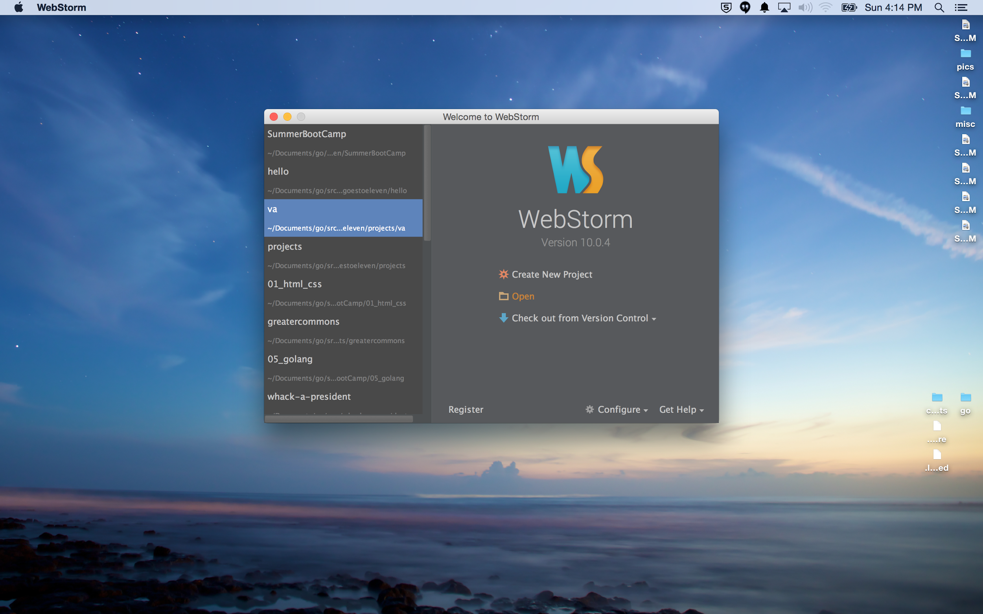
open your repo in webstorm ...

Slide 9
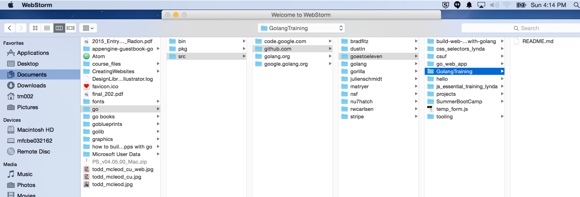
open your repo in webstorm ...

Slide 10
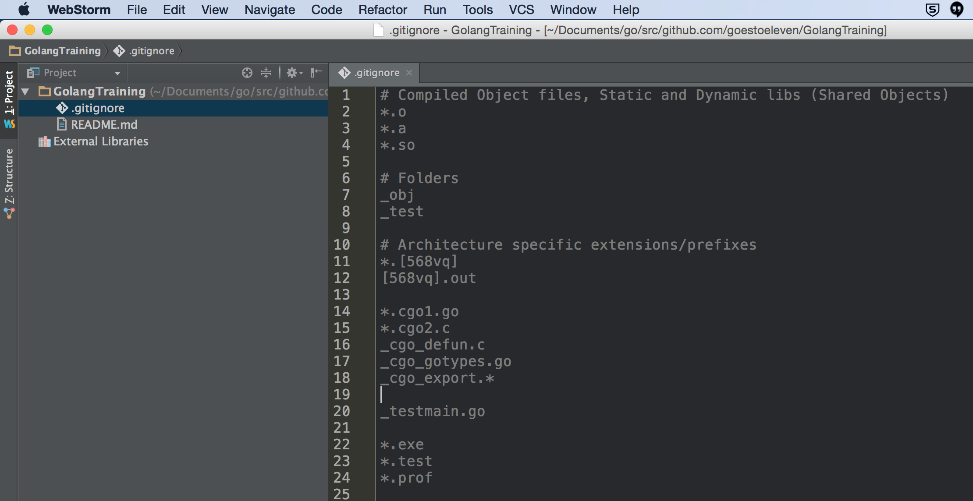
This is the default .gitignore file for go projects.
The .gitignore file tells git / github to not track these files listed here (it ignores these files, thus, .gitignore)

Slide 11
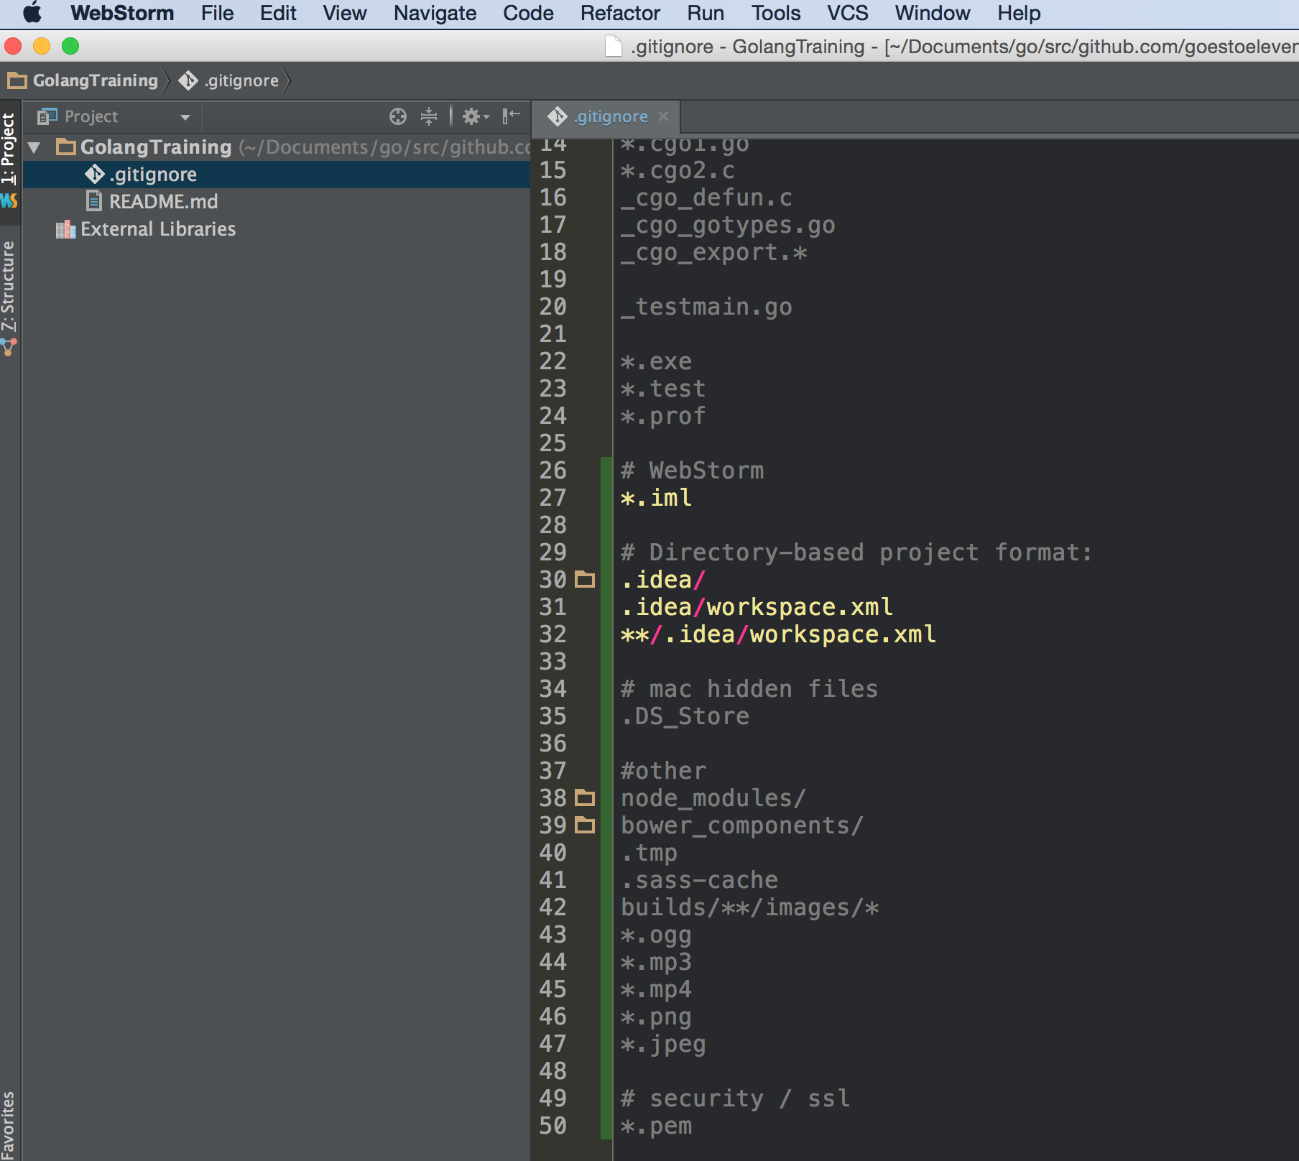
I always ignore
these webstorm files
I sometimes ignore
these other files

Slide 12
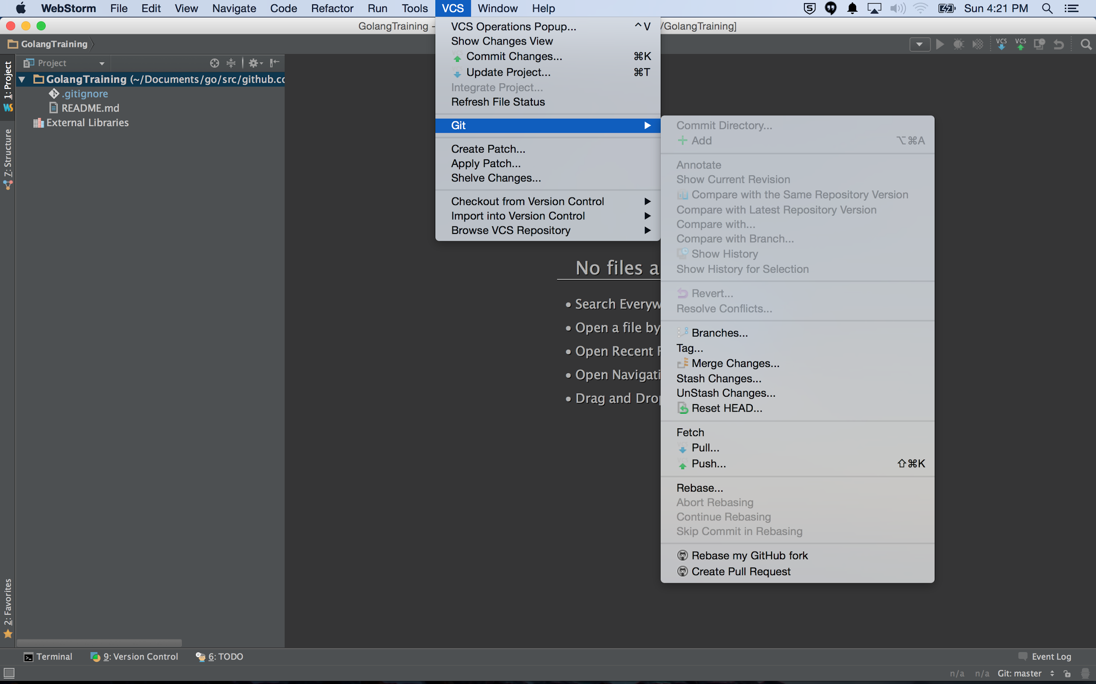
use webstorm for github commits

Slide 13
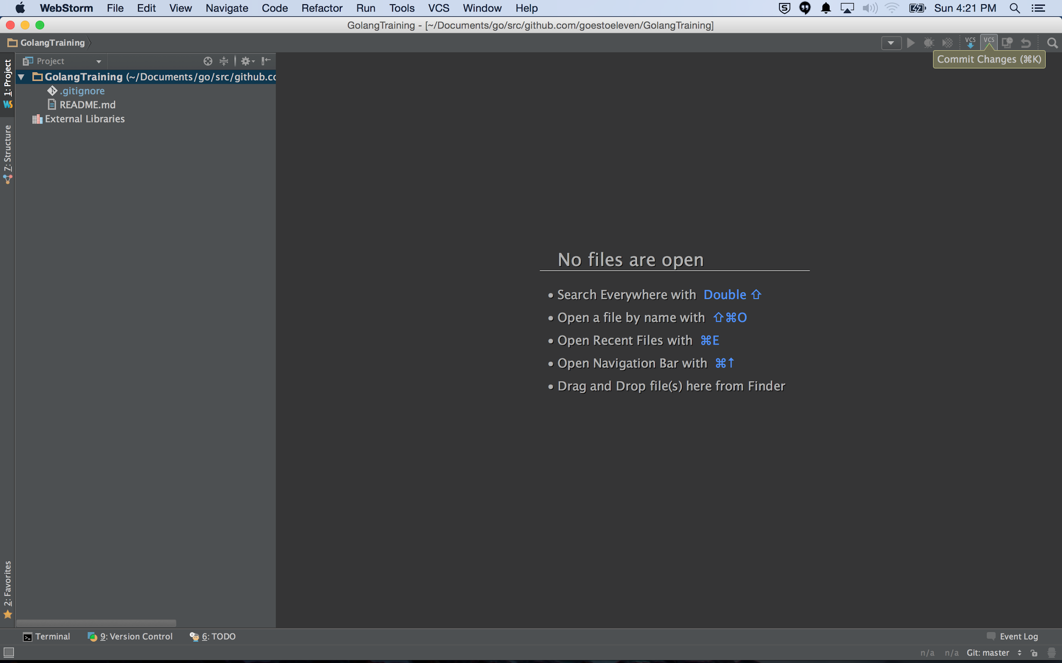
use webstorm for github commits

Slide 14
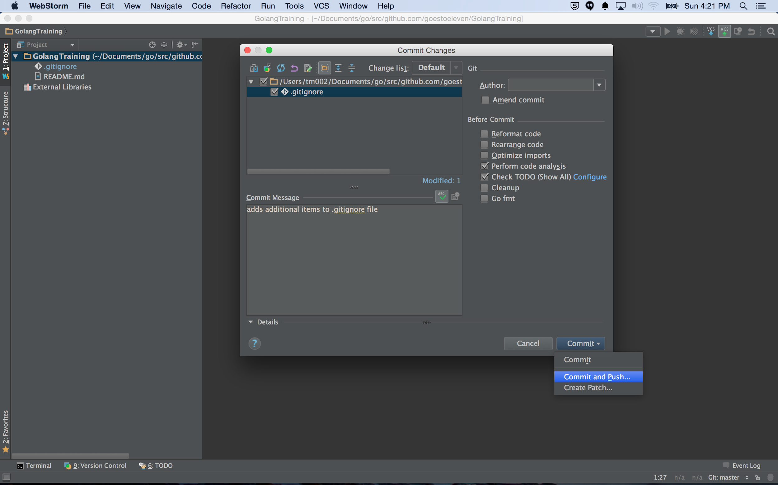
use webstorm for github commits

Slide 15
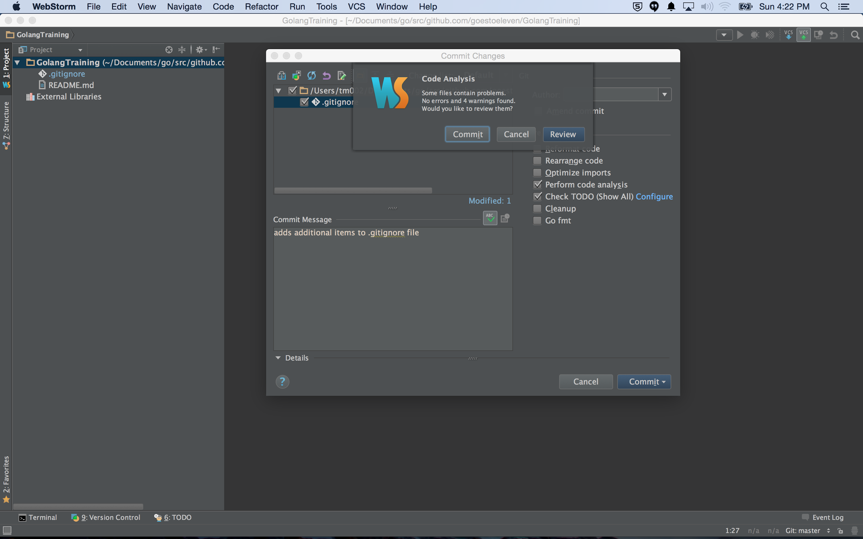
use webstorm for github commits

Slide 16
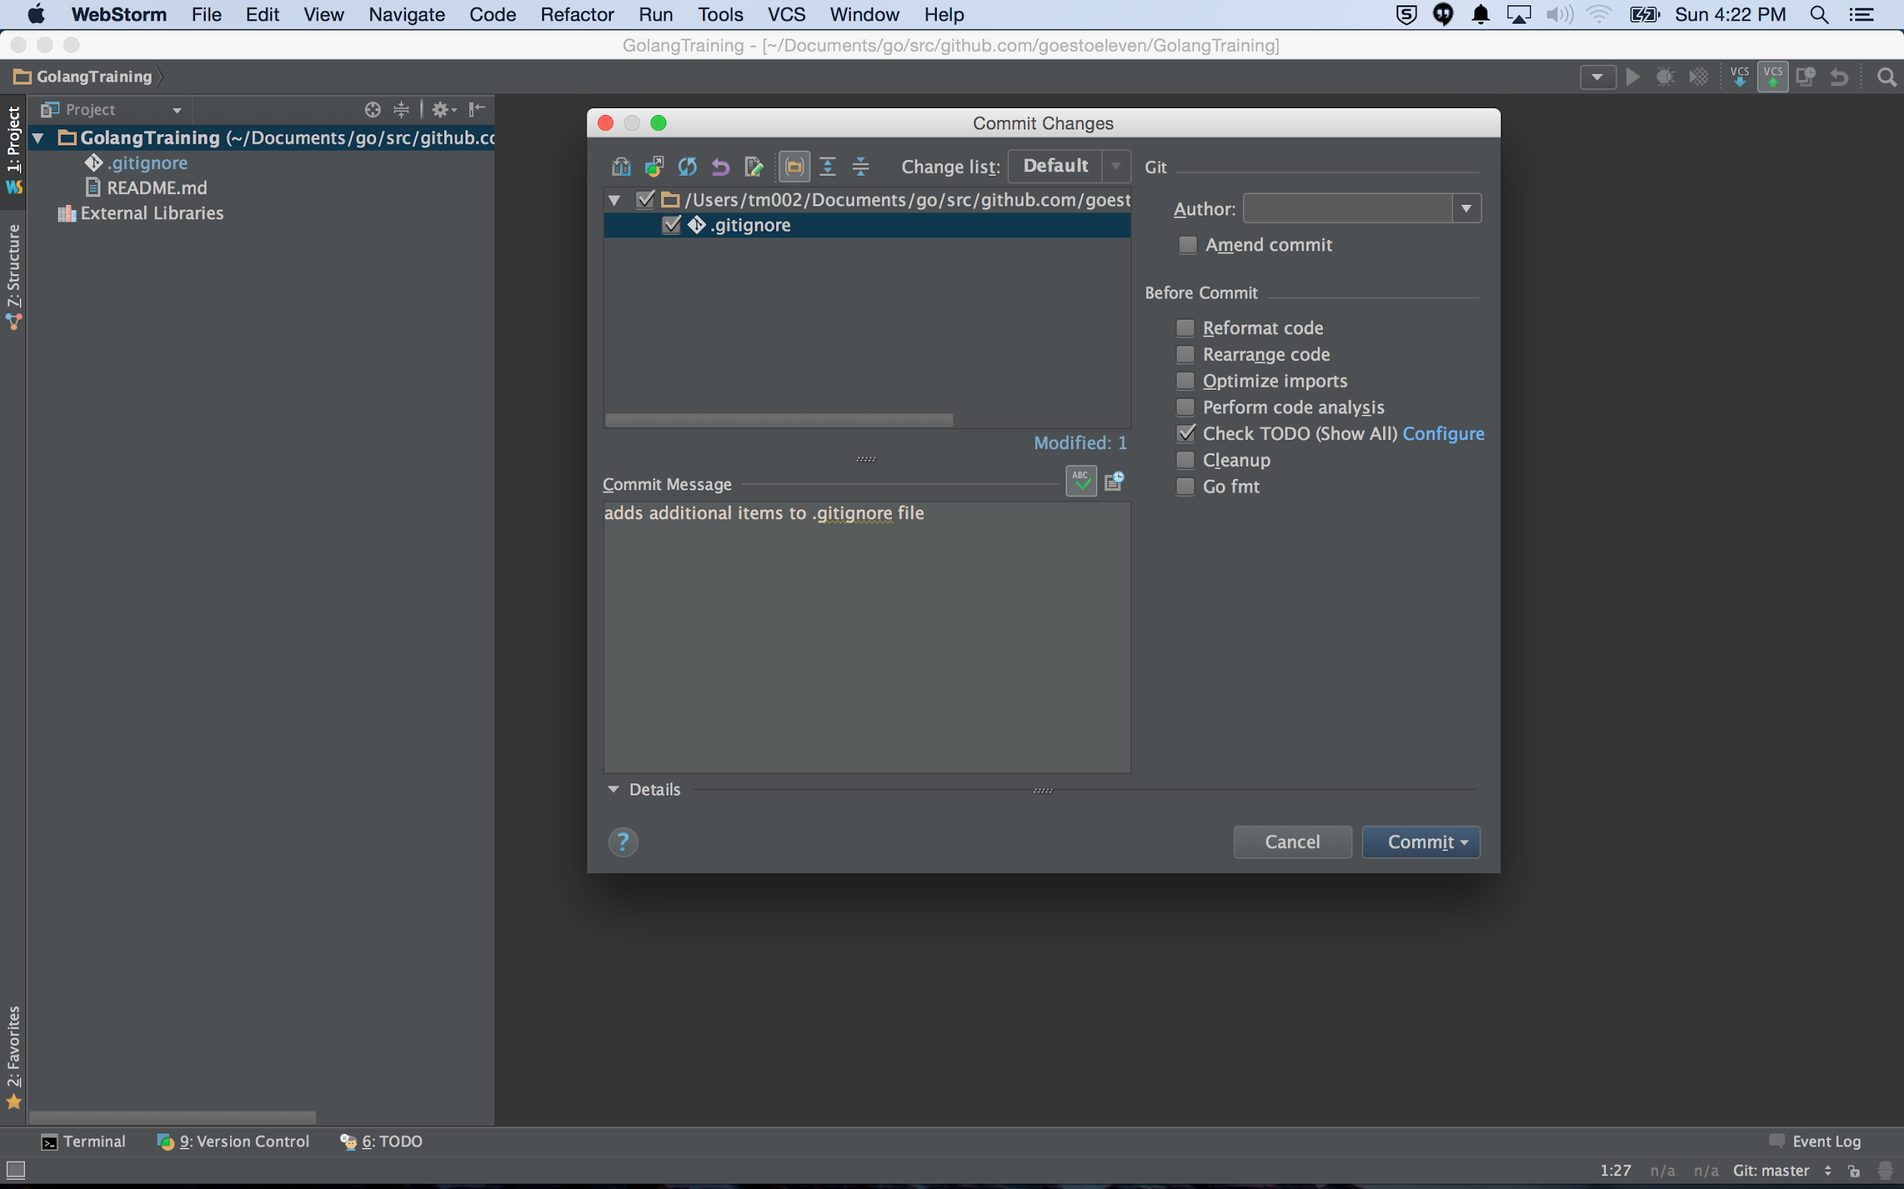
use webstorm for github commits

Slide 17

use webstorm for github commits

Slide 18
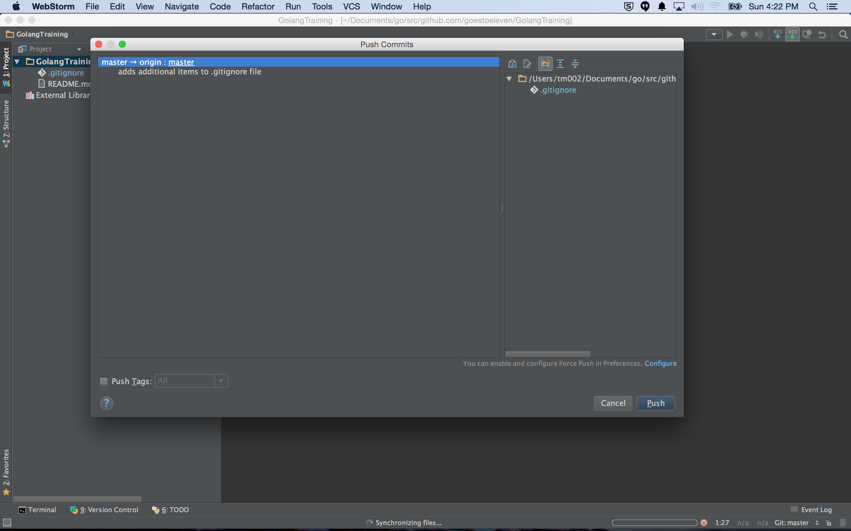
use webstorm for github commits

Slide 19
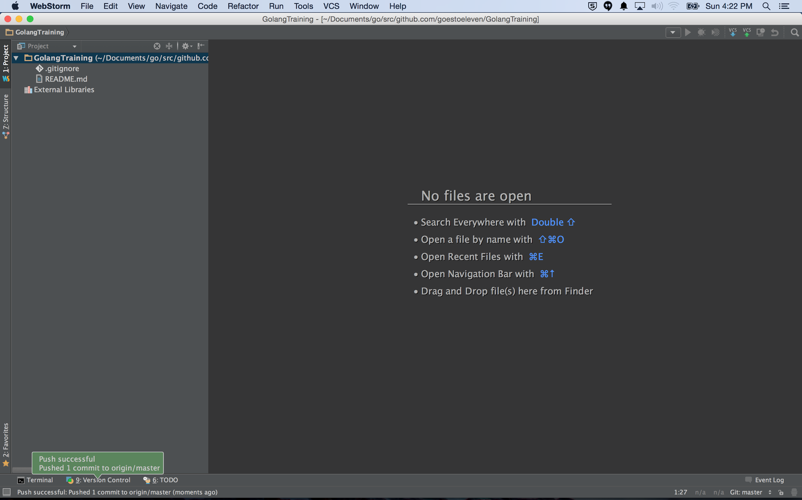
use webstorm for github commits

Slide 20
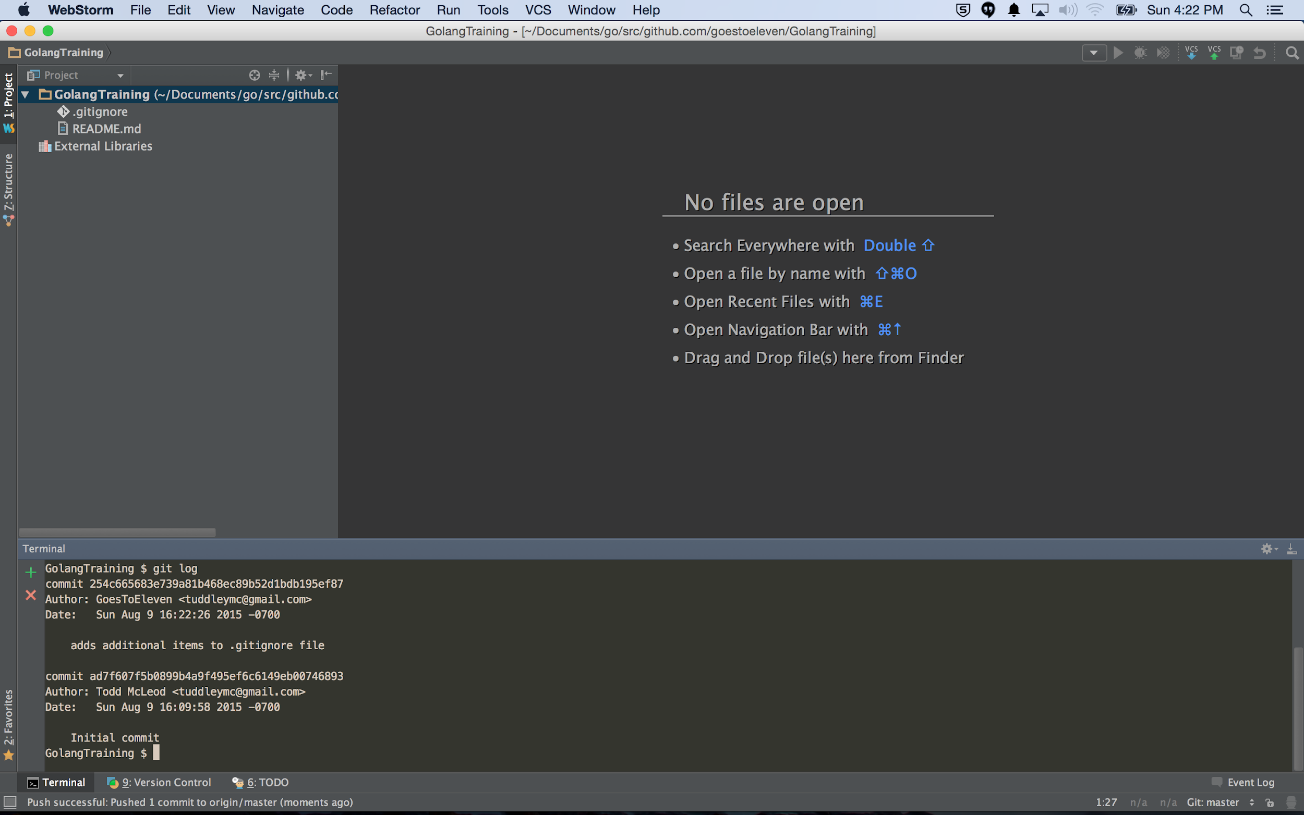
checking commits at terminal
using “git log” ...

Slide 21
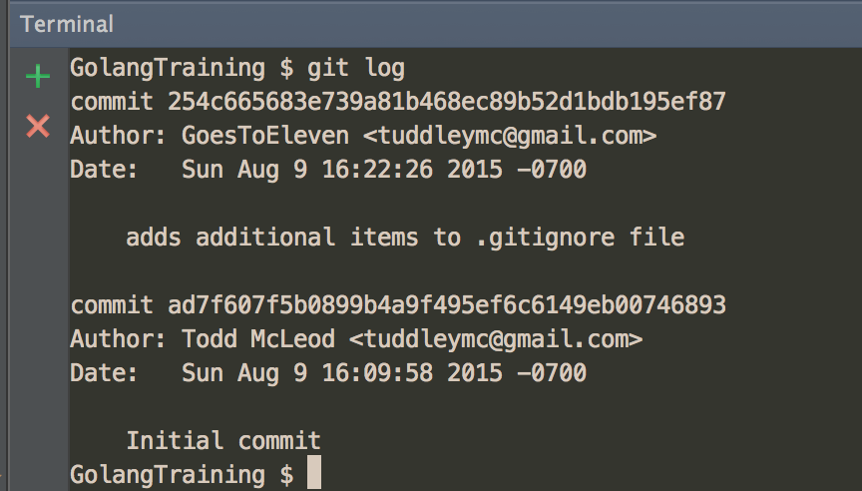
checking commits at terminal
using “git log” ...

Slide 22
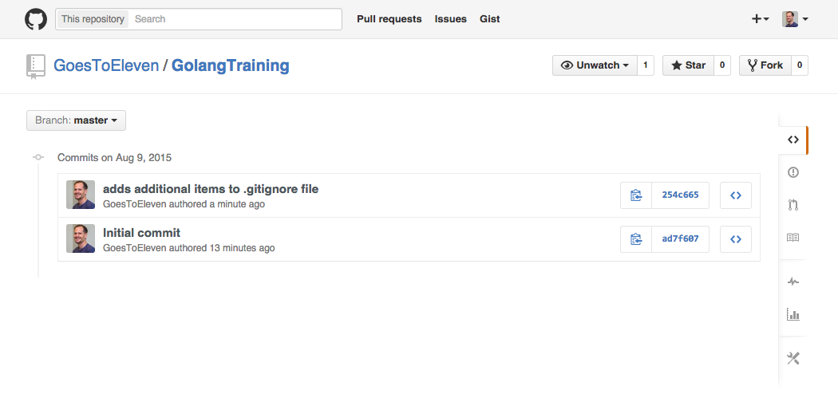
checking commits on github ...
checking commits at github.com

Slide 23
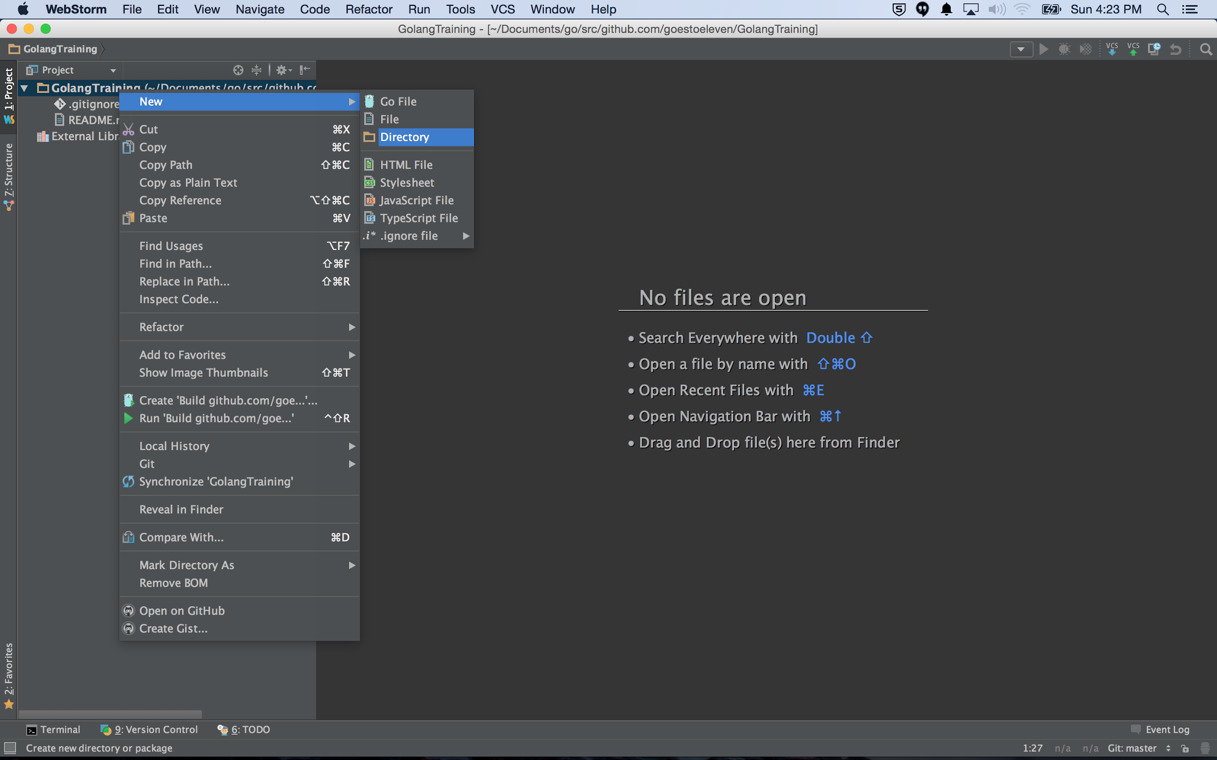
re-creating hello world

Slide 24
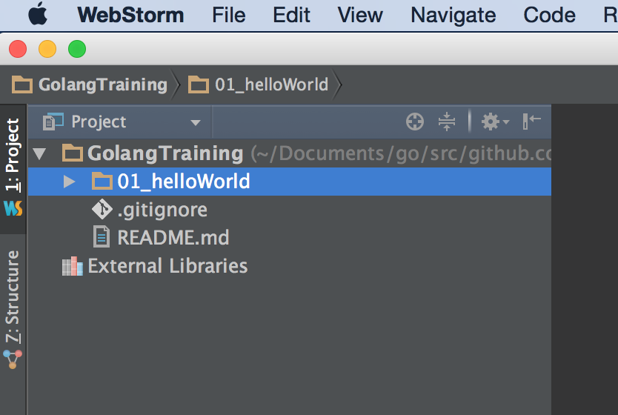
re-creating hello world

Slide 25
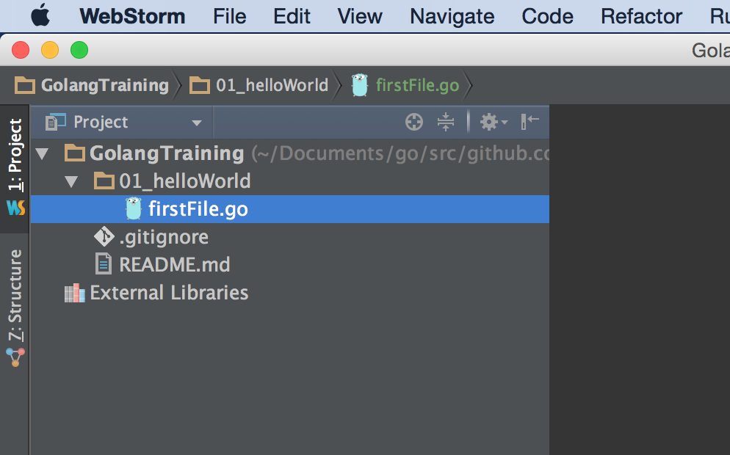
re-creating hello world

Slide 26
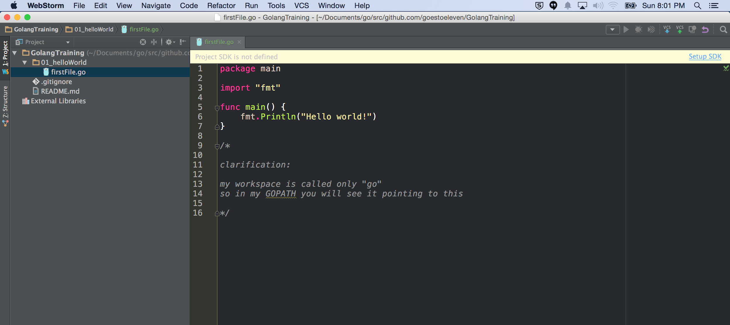
re-creating hello world

Slide 27
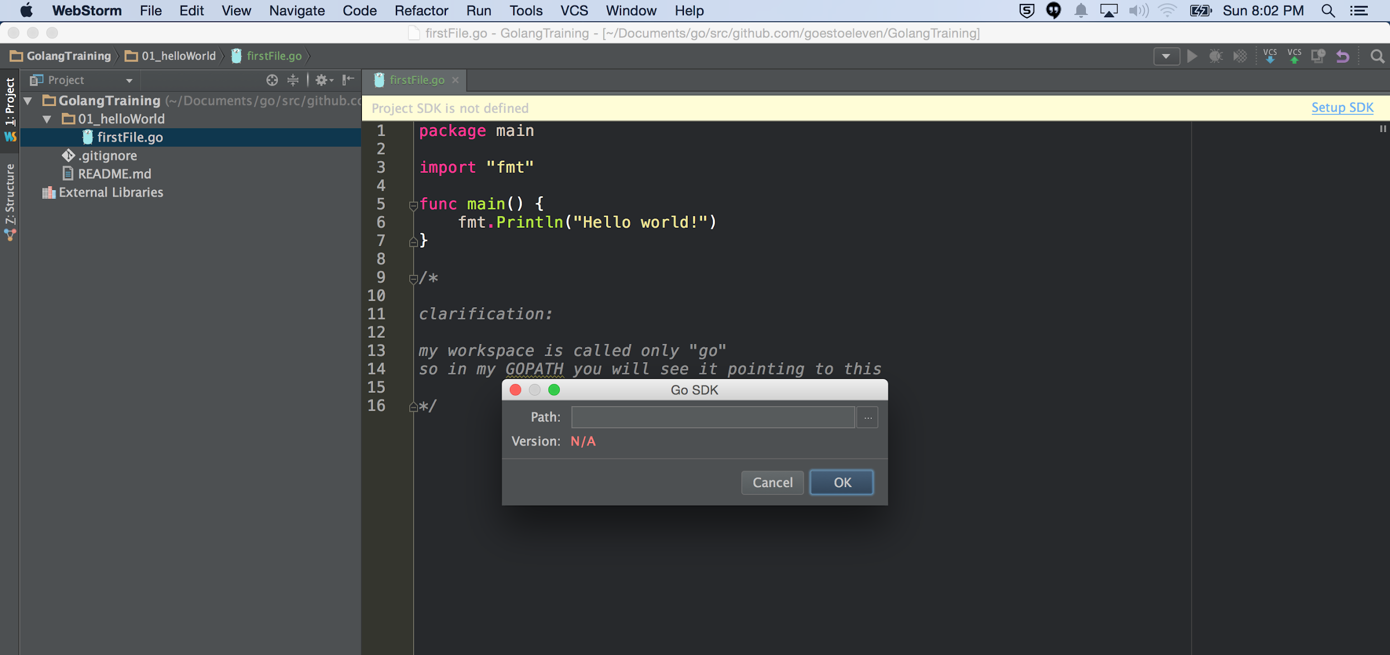
re-creating hello world
setting the Go SDK path in webstorm

Slide 28
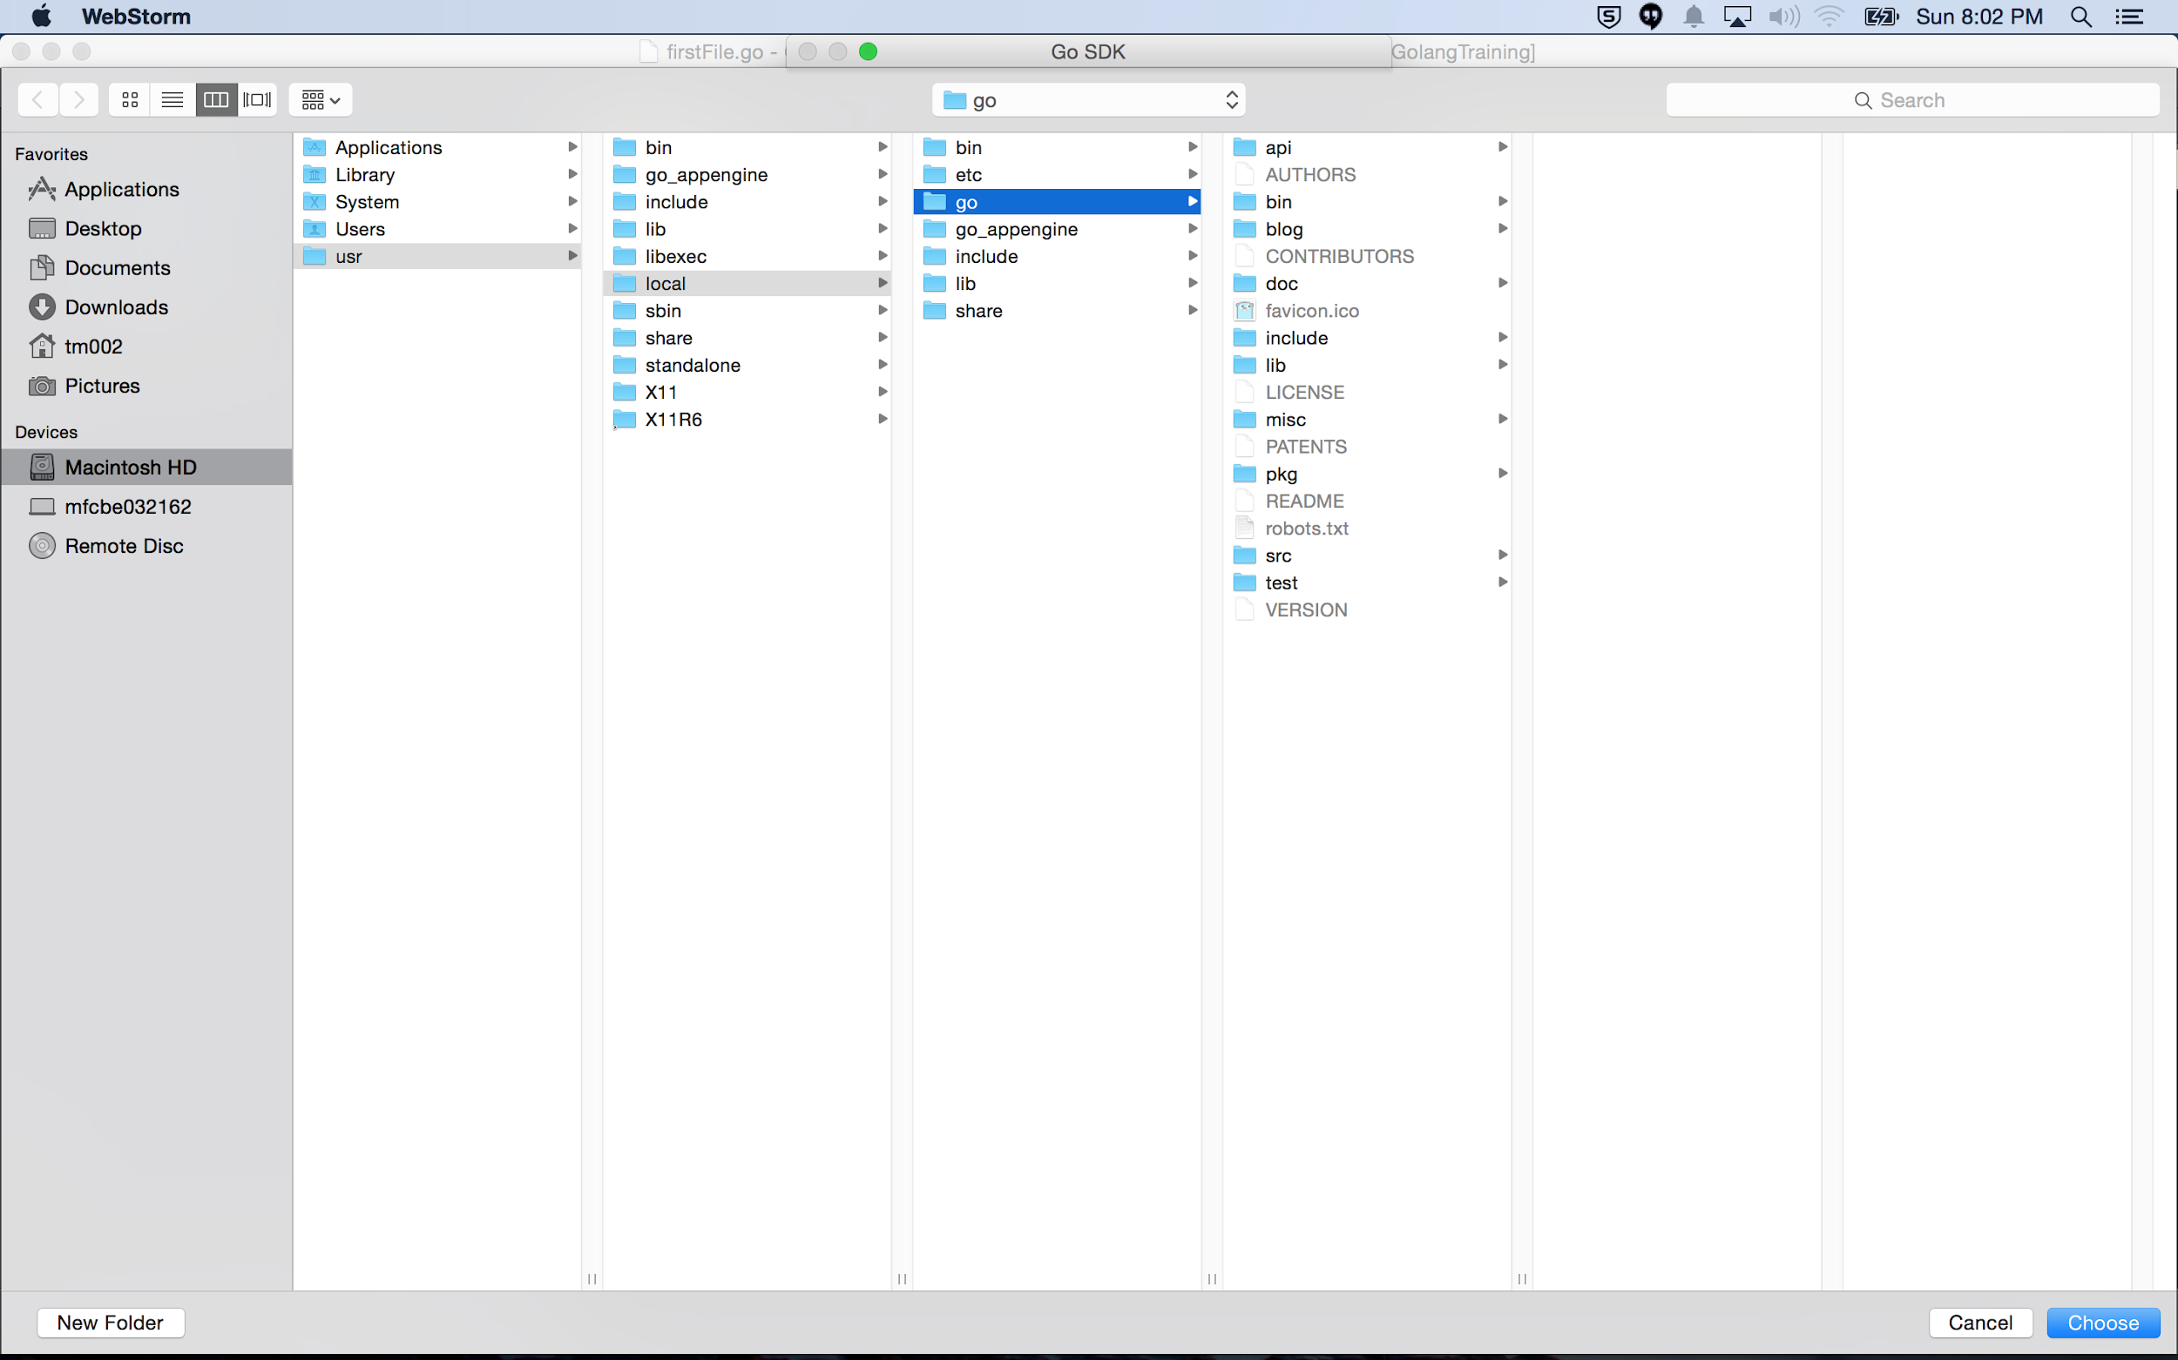
re-creating hello world
setting the Go SDK path in webstorm

Slide 29
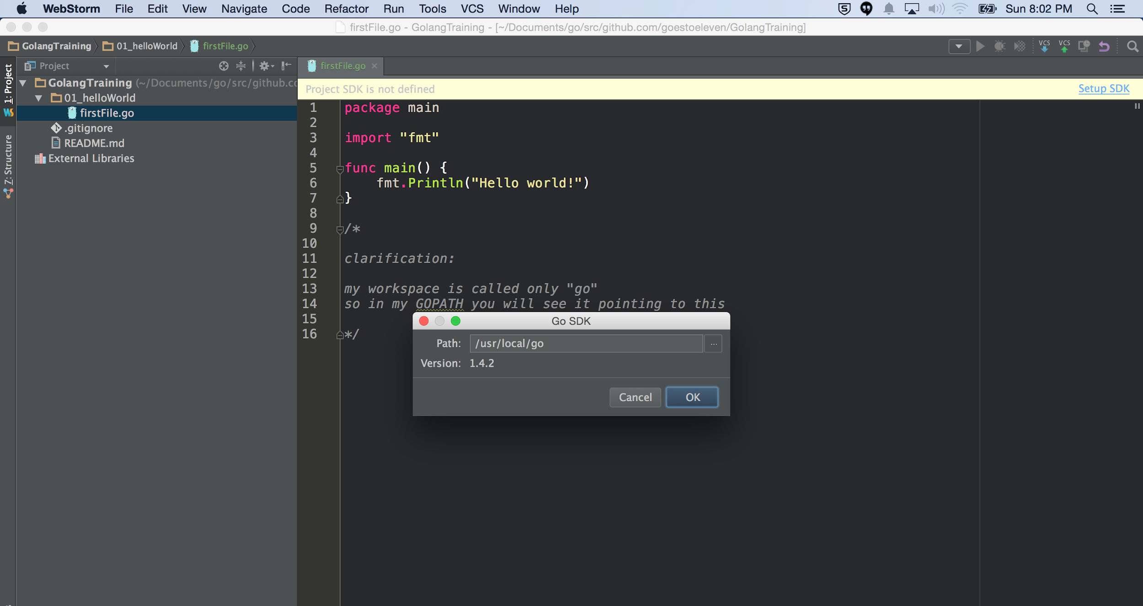
re-creating hello world
setting the Go SDK path in webstorm

Slide 30
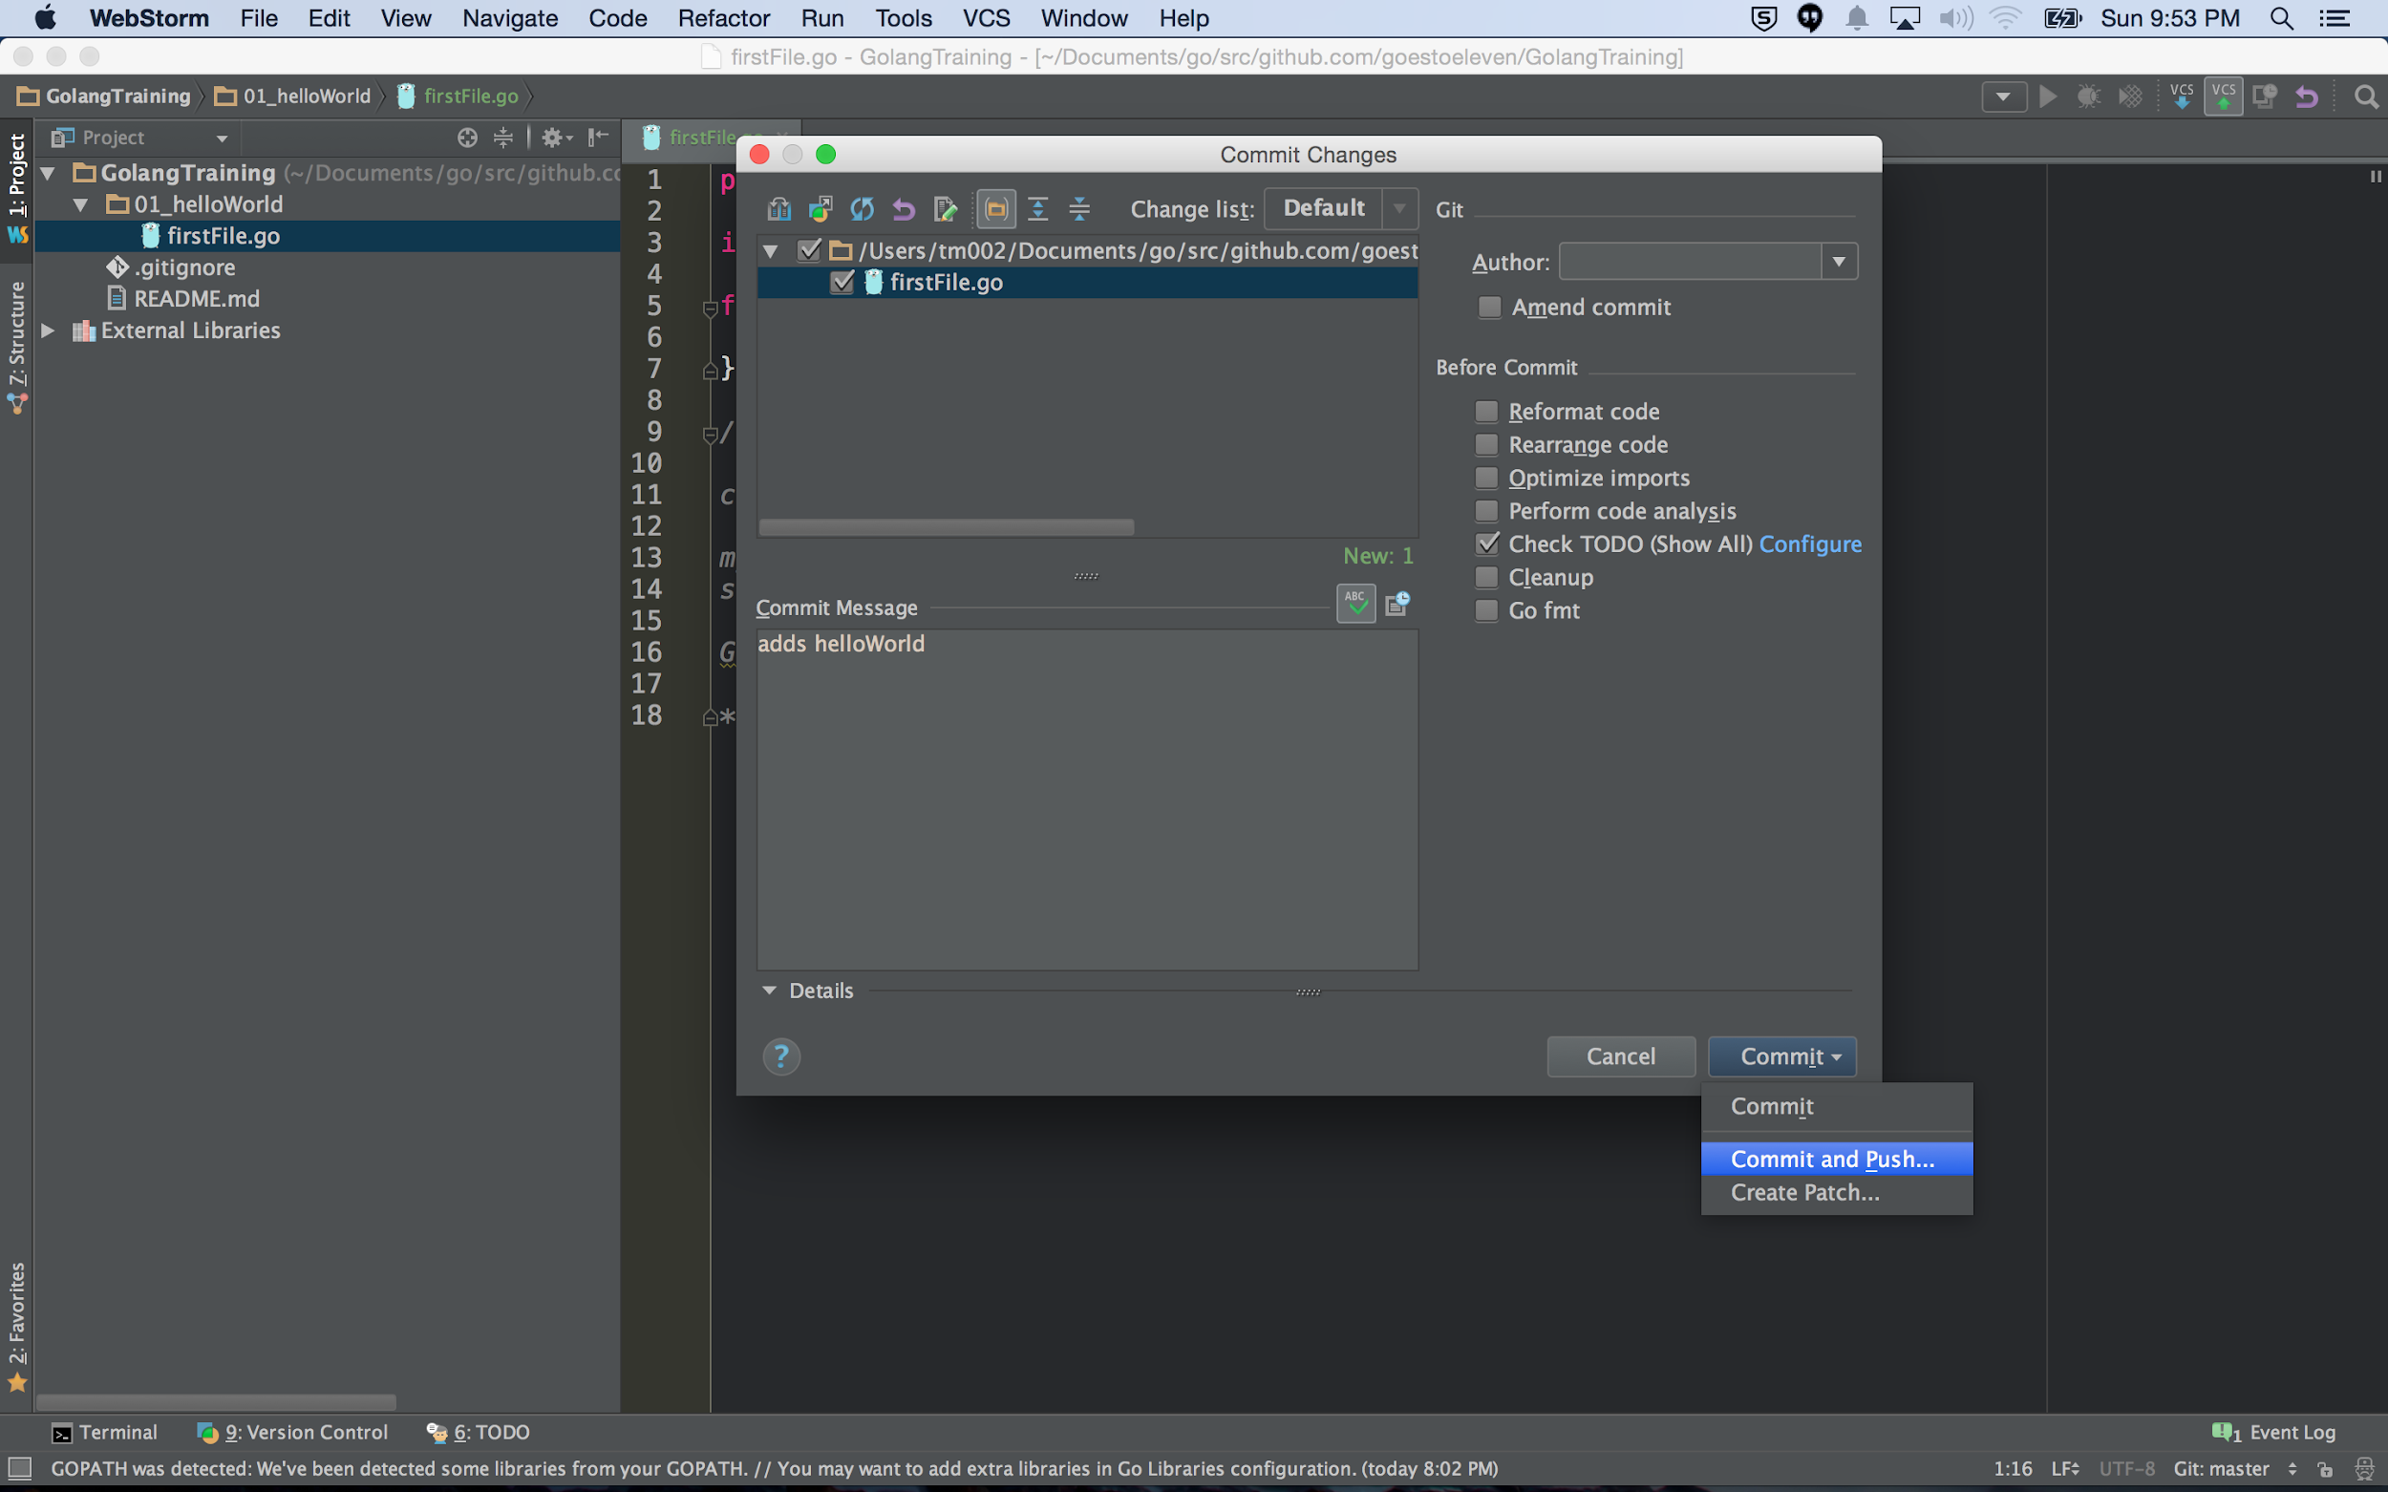
re-creating hello world
pushing our changes to github

Slide 31
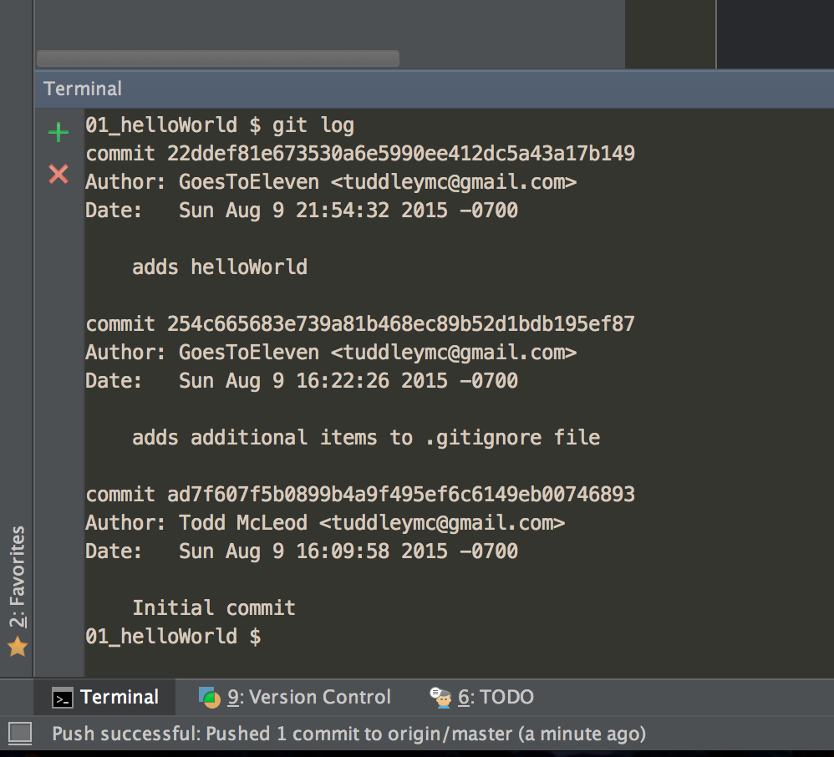
re-creating hello world
checking git log

Slide 32
go get
let’s see how go get
goes and gets code so we can use it
download and install packages and dependencies
go get
allows us to go get code → this brings the code into our workspace where we can use it.
I’m going to “go get” the golangtraining code we just created …
… but first ...

Slide 33
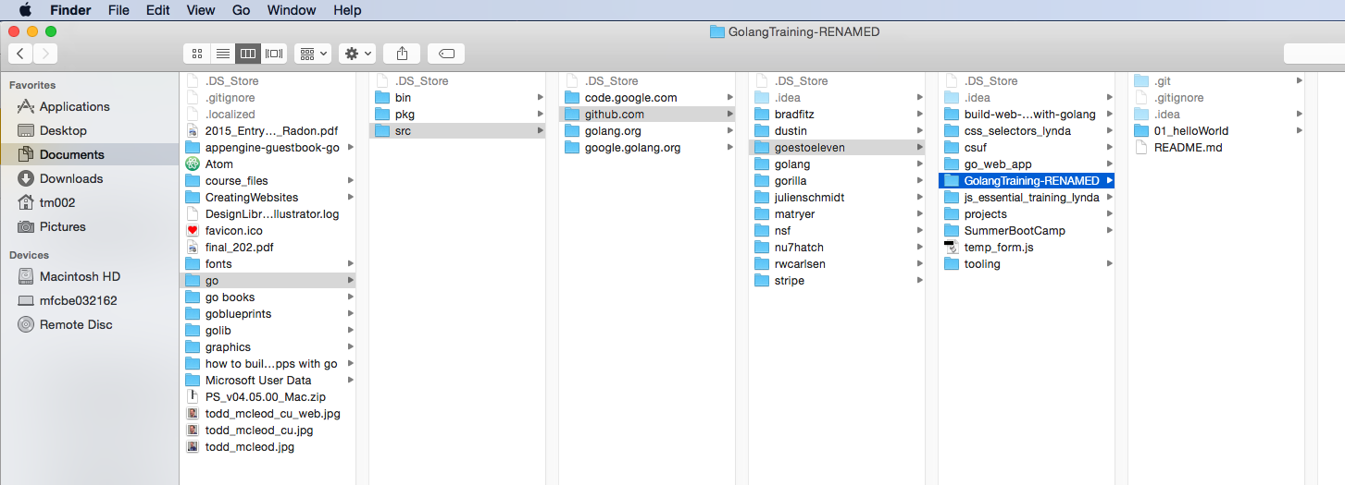
… I’m going to rename my package so that when I “go get” the golangtraining package, it won’t already exist in my workspace

Slide 34
Now I’ll run this command at the terminal ...
go get github.com/goestoeleven/golangtraining

Slide 35
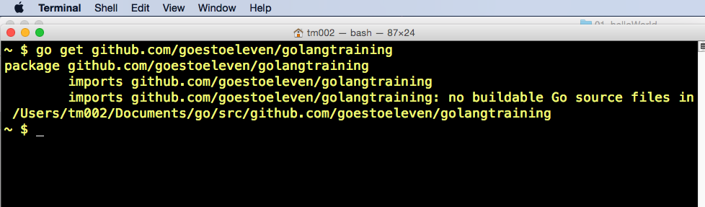
Now I’ll run this command at the terminal ...

Slide 36
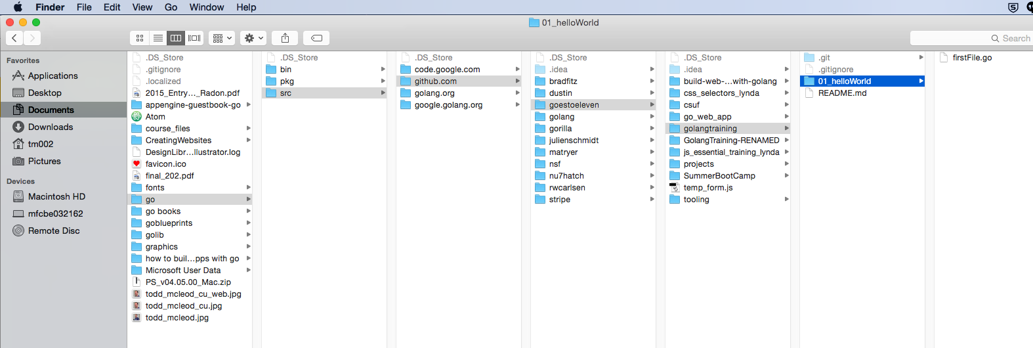
And you can see, it went and got that code then added it to my workspace.

Slide 37
Review
create a new github repo
clone the repo to your desktop
choose the correct location
sequentially organizing go code
idiomatic
.gitignore
.gitignore settings
using webstorm for github commits
checking commits
using “git log” at terminal
on github.com
re-creating “hello world”
go get

Slide 38
Review Questions

Slide 39
Github
if you haven’t done so already
create a github.com account
create a repo for this class
add a .gitignore file
if you are using webstorm, modify the .gitignore file appropriately
take a screenshot of your .gitignore file
put the screenshot in your Google Drive document which you will submit for this assignment
note: taking screenshots only applies to students taking my course; if you are viewing these resources and you are not in my course, please please please do not randomly send me screenshots.

Slide 40
Github
create the “hello world” program
commit your code to github
look at your “hello world” code on github
take a screenshot of this
put the screenshot in your Google Drive document which you will submit for this assignment
(I am not going to repeat these instructions again, so remember to put screenshots in your Google Drive document when you see “take a screenshot of this”)

Slide 41
Github
run git log at the terminal
take a screenshot of this

Slide 42
go get
use godoc.org to find some package
run go get at the terminal to get that package
look in finder to see where that package was stored
take a screenshot of this
delete the package from your workspace

